Slide 1


Slide 2
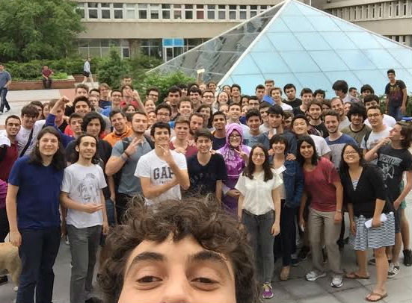
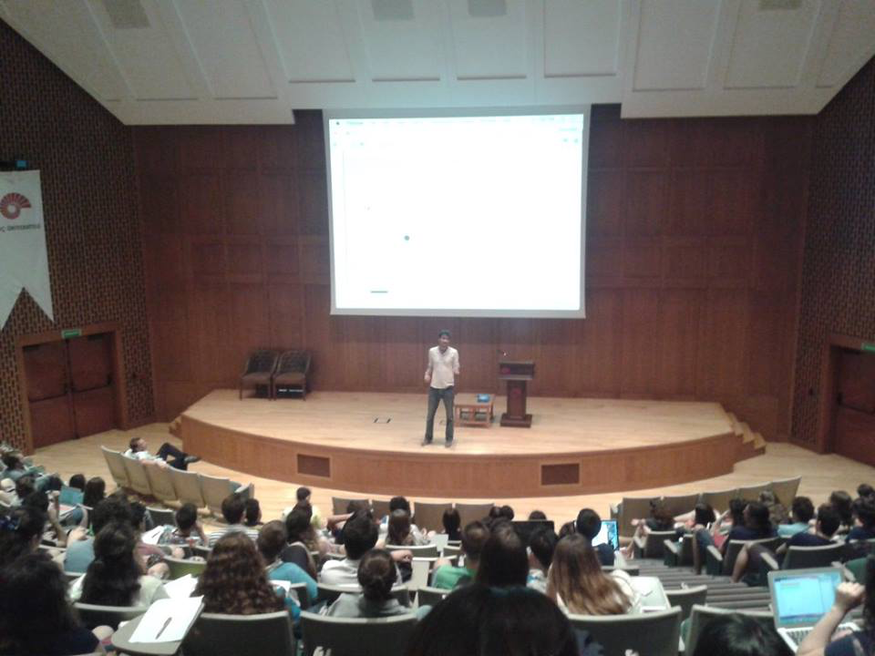
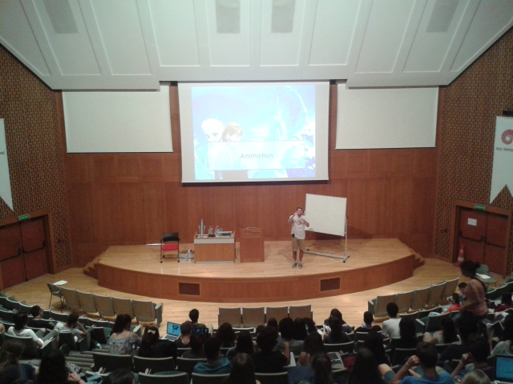
Boğaziçi Ünv. 2015
Darüşşafaka Lisesi. 2014
Koç Ünv. 2016
Koç Ünv. 2017

Slide 3
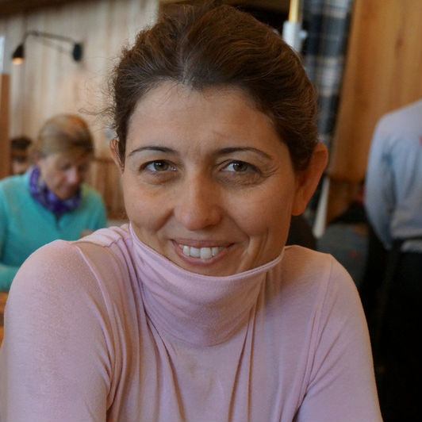

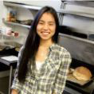
Asena Bryce Julia

Slide 4
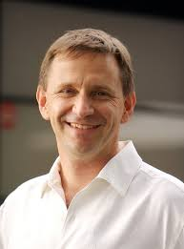
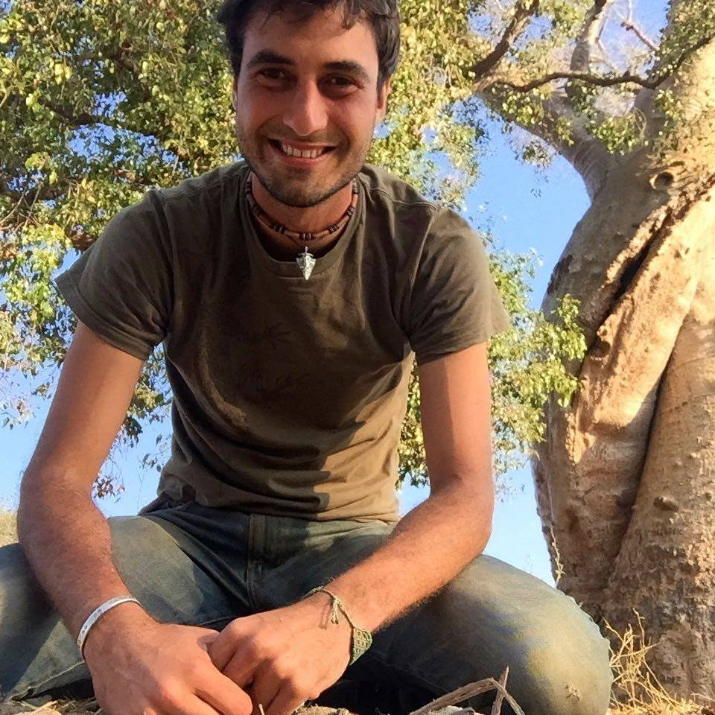
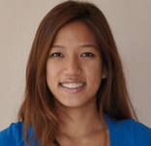
Nick Chris Lisa

Slide 5
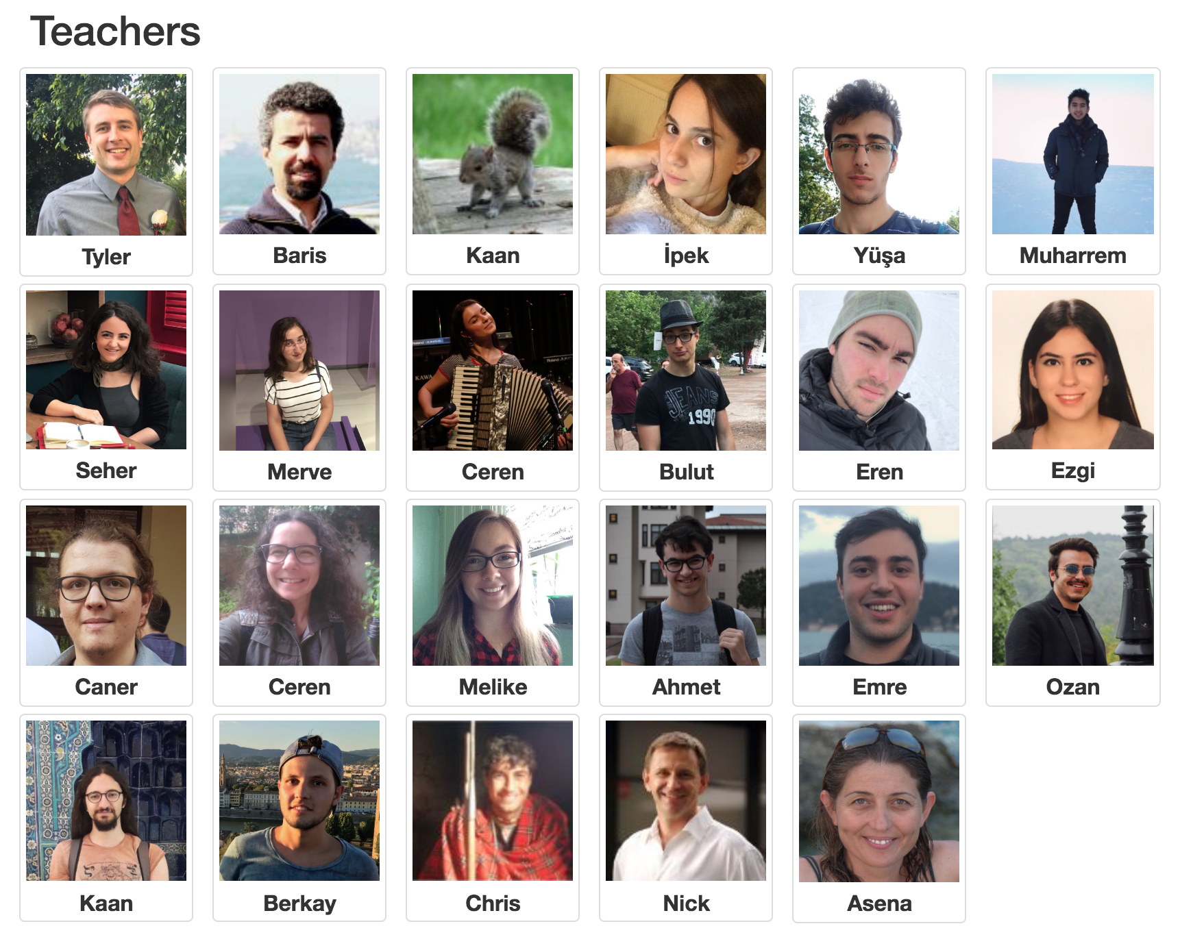
Great team!

Slide 6
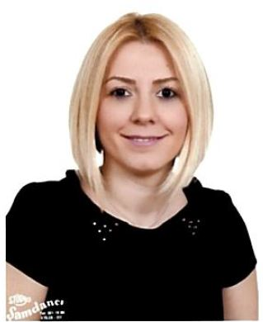
Pelin
Barış Yazar

Slide 7
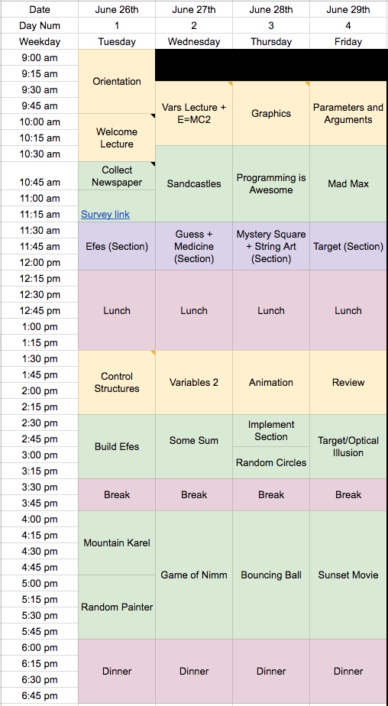
Logistics
Notes:
Schedule is fluid
Explain purpose of lab/section.
Learn by doing!!

Slide 8
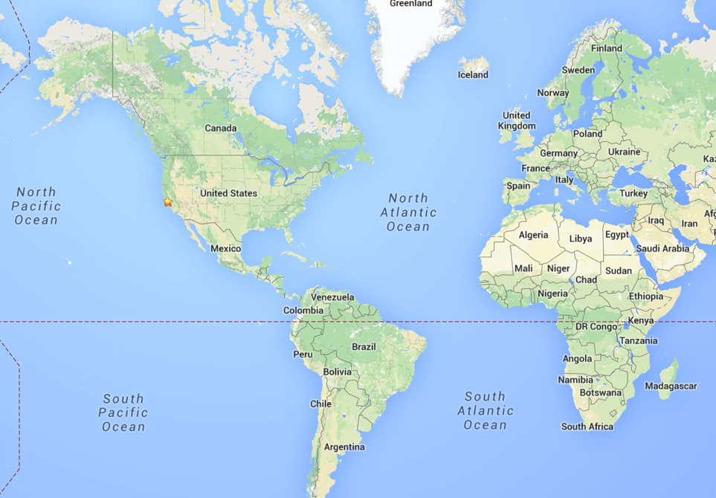
Stanford?
Notes:
Language
Call me Tyler
I grew up in Arizona. Played a lot of soccer growing up. Really liked math. Now I rock climb a lot.

Slide 9
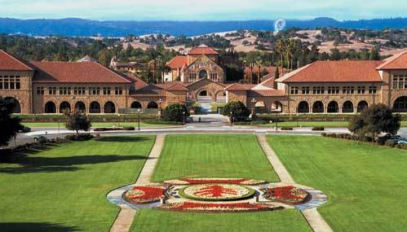
Stanford
Notes:
I was a graduate student in Electrical Engineering at Stanford
How much experience did I have when I first did this material?
It was difficult for me too.
Started teaching in section leading program. I coordinated that program.
We want all of you to be successful
That’s why we have such a large course staff
But over years and years and years we have been working on our material so that everyone gets through…
Not competing against anyone but yourself. Everyone can win!

Slide 10
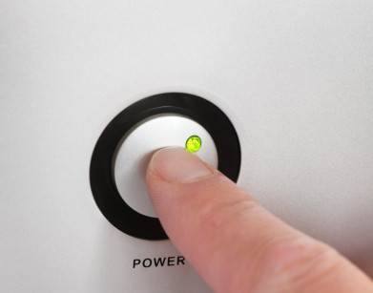
Prerequisites
Notes:
Just need to know how to turn on a computer and ask for help.
We love questions!!!

Slide 11
Course Website
http://koc.csbridge.org
*note that its org not com
Notes:
Link to sign into lab

Slide 12
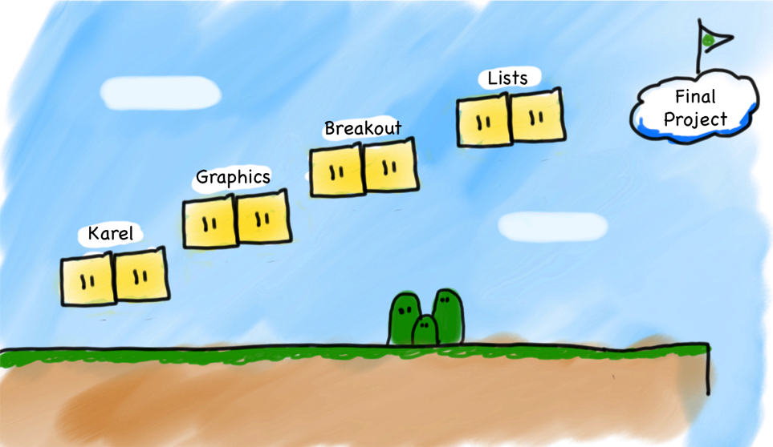
Very High Level
Notes:
We will teach some specific things (Java syntax, Karel commands) but more importantly…
We teach software engineering principles. Much larger than just programming.
Mechanics of the language are nothing compared to the principles.
You are going to learn the principles by programming in Java

Slide 13
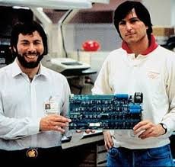
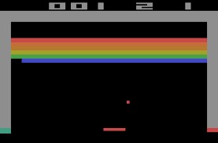
Notes:
Breakout demo!

Slide 14
Breakout
Notes:
Breakout demo!

Slide 15
What if I fall behind?
Notes:
First, it is okay! Everyone learns at a different pace.
Ask for help.

Slide 16
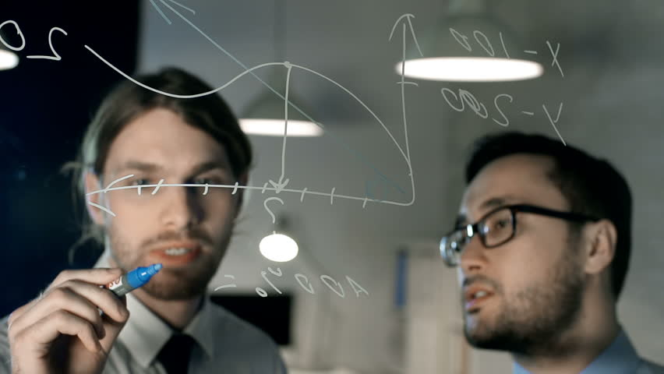
Share Ideas Not Code

Slide 17


Karel Speaks Java
s
Notes:
Karel is a gentle introduction to programming

Slide 18


Karel’s World
North
3
+
+
+
+
+
2
+
+
+
+
+
West
East
1
+
+
+
+
+
South
1
2
3
4
5

Slide 19
Knows Four Commands
move();
turnLeft();
putBeeper();
pickBeeper();

Slide 20

Walls
3
+
+
+
+
2
+
+
+
+
1
+
+
+
+
1
2
3
4

Slide 21

Beepers
3
+
+
+
+
2
+
+
+
+
1
+
+
+
+
1
2
3
4

Slide 22
move();

Slide 23

move();
3
+
+
+
+
2
+
+
+
+
1
+
+
+
+
1
2
3
4

Slide 24
move();
3
+
+
+
+
2
+
+
+
+
1
+
+
+
+
+
1
2
3
4

Slide 25
turnLeft();

Slide 26
turnLeft();
3
+
+
+
+
2
+
+
+
+
1
+
+
+
+
+
1
2
3
4

Slide 27
turnLeft();
3
+
+
+
+
2
+
+
+
+
1
+
+
+
+
+
1
2
3
4

Slide 28
pickBeeper();

Slide 29
pickBeeper();
3
+
+
+
+
2
+
+
+
+
1
+
+
+
+
+
1
2
3
4

Slide 30
pickBeeper();
3
+
+
+
+
2
+
+
+
+
1
+
+
+
+
+
1
2
3
4

Slide 31
Questions?

Slide 32
First Challenge
3
+
+
+
+
2
+
+
+
+
1
+
+
+
+
1
2
3
4

Slide 33
First Challenge
3
+
+
+
+
2
+
+
+
+
1
+
+
+
+
1
2
3
4

Slide 34

Need a Volunteer

Slide 35

Lets Try It

Slide 36
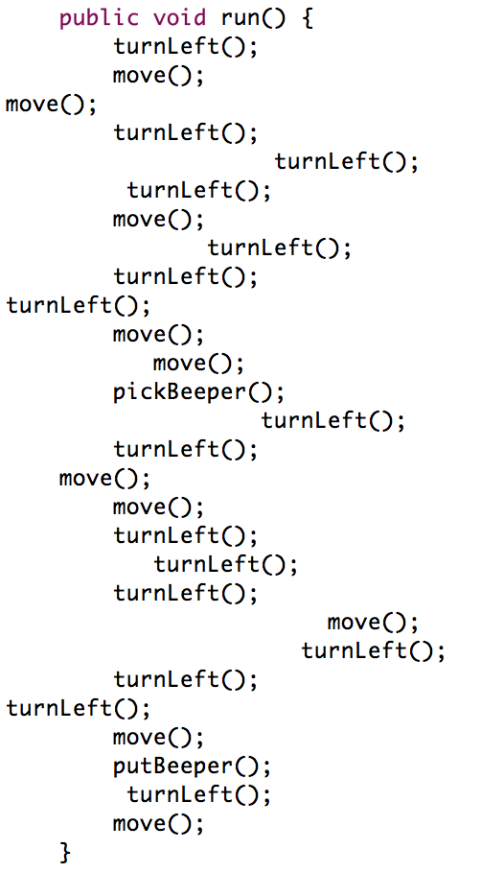
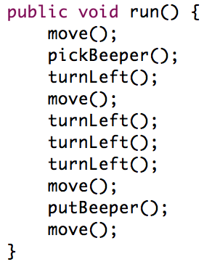
Program Style

Slide 37
Questions?

Slide 38
Anatomy of a Program
import stanford.karel.*;
public class OurKarelProgram extends Karel {
public void run() {
move();
pickBeeper();
move();
turnLeft();
move();
turnRight();
move();
putBeeper();
move();
}
private void turnRight() {
turnLeft();
turnLeft();
turnLeft();
}
}

Slide 39
Anatomy of a Program
import stanford.karel.*;
public class OurKarelProgram extends Karel {
public void run() {
move();
pickBeeper();
move();
turnLeft();
move();
turnRight();
move();
putBeeper();
move();
}
private void turnRight() {
turnLeft();
turnLeft();
turnLeft();
}
}
This is the program's source code

Slide 40
Anatomy of a Program
import stanford.karel.*;
public class OurKarelProgram extends Karel {
public void run() {
move();
pickBeeper();
move();
turnLeft();
move();
turnRight();
move();
putBeeper();
move();
}
private void turnRight() {
turnLeft();
turnLeft();
turnLeft();
}
}
This piece of the program's source code is called a method.

Slide 41
Anatomy of a Program
import stanford.karel.*;
public class OurKarelProgram extends Karel {
public void run() {
move();
pickBeeper();
move();
turnLeft();
move();
turnRight();
move();
putBeeper();
move();
}
private void turnRight() {
turnLeft();
turnLeft();
turnLeft();
}
}
This line of code gives the name of the method
(here, run)

Slide 42
Anatomy of a Program
import stanford.karel.*;
public class OurKarelProgram extends Karel {
public void run() {
move();
pickBeeper();
move();
turnLeft();
move();
turnRight();
move();
putBeeper();
move();
}
private void turnRight() {
turnLeft();
turnLeft();
turnLeft();
}
}
This line of code gives the name of the method
(here, turnRight)

Slide 43
Anatomy of a Program
import stanford.karel.*;
public class OurKarelProgram extends Karel {
public void run() {
move();
pickBeeper();
move();
turnLeft();
move();
turnRight();
move();
putBeeper();
move();
}
private void turnRight() {
turnLeft();
turnLeft();
turnLeft();
}
}
This is called an import statement. It tells Java what Karel is.

Slide 44
Anatomy of a Program
import stanford.karel.*;
public class OurKarelProgram extends Karel {
public void run() {
move();
pickBeeper();
move();
turnLeft();
move();
turnRight();
move();
putBeeper();
move();
}
private void turnRight() {
turnLeft();
turnLeft();
turnLeft();
}
}
This is called a code block
Notes:
Talk about indentation

Slide 45
Method Definition
private void name() {
statements in the method body
}
This adds a new command to Karels vocabulary

Slide 46
Program Style
import stanford.karel.*;
public class OurKarelProgram extends Karel {
public void run() {
move();
pickBeeper();
move();
turnLeft();
move();
turnRight();
move();
putBeeper();
move();
}
private void turnRight() {
turnLeft();
turnLeft();
turnLeft();
}
}
Notes:
Talk about indentation

Slide 47
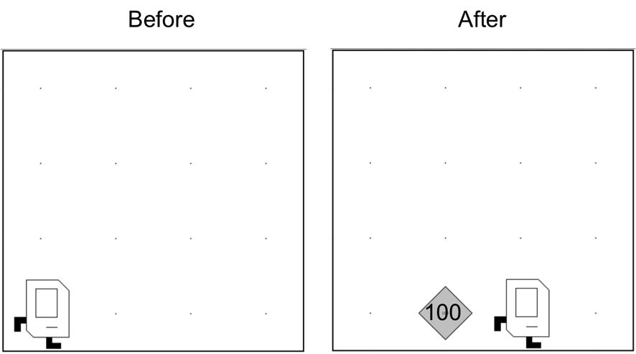
Place 100 beeper?

Slide 48
For Loop
for(int i = 0; i < N; i++) {
// to repeat N times
}

Slide 49
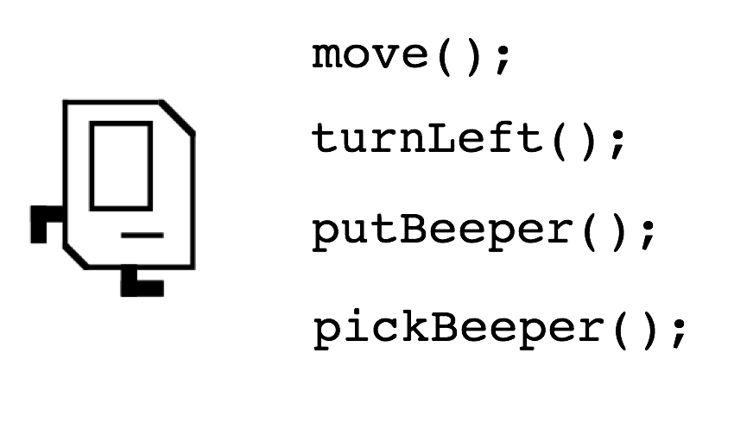
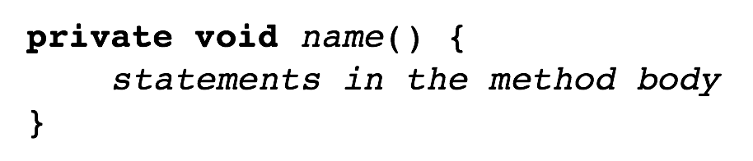
Review
for(int i = 0; i < N; i++) {
// to repeat N times
}

Slide 50
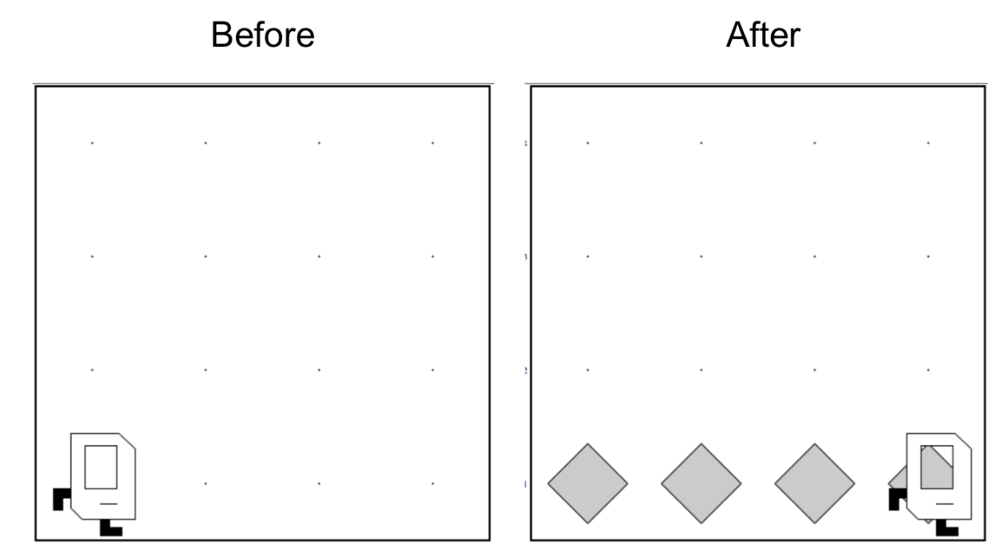
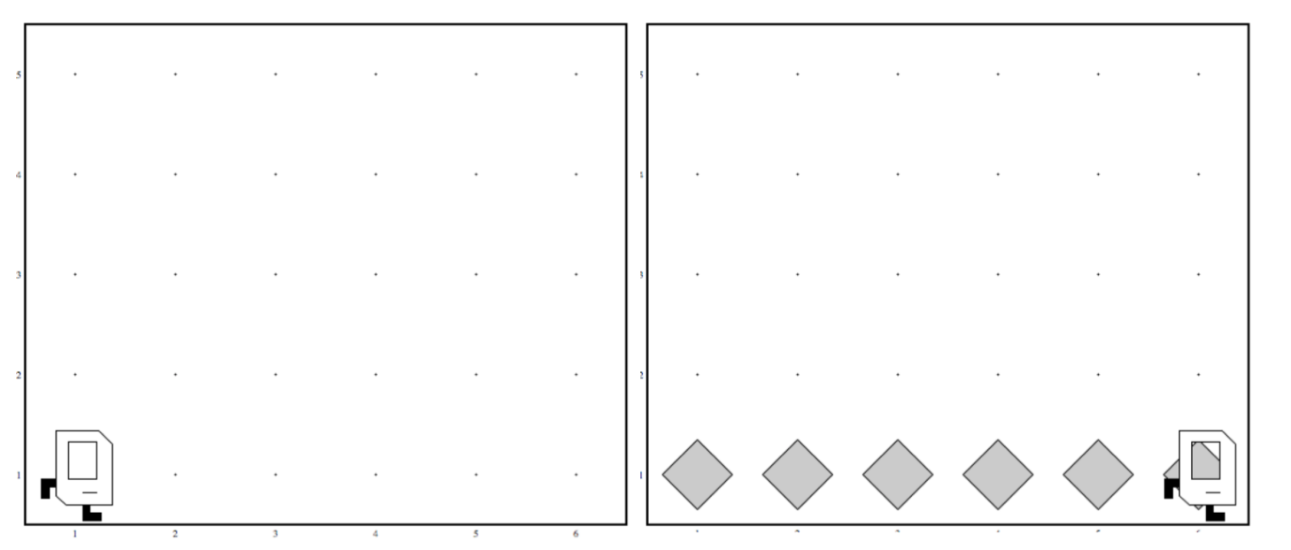
Work in Any World
Before
After
Before
After
Notes:
What will I learn next time?

Slide 51
Don’t Know World Size
?

